Slide 1
JavaScript // jQuery Review & Timing Events

Slide 2
Class Objectives
Reinforce knowledge of JavaScript & jQuery.
Understand JavaScript Timing Events including setTimeout, clearTimeout, & setInterval.
Experience working on, and talking about code with other developers.
Implement complex logical conditions to meet an objective.

Slide 3
Coin Flipper Activity
Make a Coin Flipper game.
Follow the directions in the html file.
How the app works: The user chooses Heads or Tails, and the computer randomly selects heads or tails and displays the outcome on the screen. The app then displays whether or not the user won or lost.
BONUS:
Put your JavaScript in its own file and link to it in the HTML.
Keep track of the number of Heads or Tails and display the results on the screen.
Add CSS styling.

Slide 4
$(this) Activity
Typically using jQuery $(this) selector is a good habit when you code with multiple items of the same type, or with the same class. -Chris
Work with a partner
Together, open the supplied HTML file and answer all questions.
705

Slide 5
setTimeout / clearTimeout
vanilla JavaScript methods, not jQuery!
var windowTimeout = setTimeout(function1, 5000);
clearTimeout(windowTimeout);
730

Slide 6
Execution context
“You have to be careful with $(this). You need to assign your this in the outer scope to a variable.
The this keyword always refers to the this of the current scope, which changes any time you wrap something in function() { ... }.”

Slide 7
Simple Timer Recap (0:10)
Simple Timer
Slack out the following instructions and files:
Instructions:
Make a page with a a simple timer that sends an alert and plays a sound after 15 seconds.
Have it send an alert when 5 seconds has passed, 10 seconds has passed and when the time is up.
You will use this to time the break!
745

Slide 8
Break!
755

Slide 9
setTimeout vs setInterval
setInterval fires again and again in intervals, while setTimeout only fires once.
setTimeout(expression, timeout); runs the code/function once after the timeout.
setInterval(expression, timeout); runs the code/function in intervals, with the length of the timeout between them.

Slide 10
Stopwatch Activity Activity
825

Slide 11
Stopwatch Activity!
Unzip the attached file.
Open stopwatch.js and follow the instructions in the file.
You will not not need to edit the HTML file!
Use jQuery and the timing events you learned today to create a stopwatch with Start, Stop and Reset buttons.
Bonus: Add a lap timer.
Bonus: Use CSS to style the timer

Slide 12
SlideShow Activity!
Unzip the attached file.
Create a slideshow using jQuery and JavaScript Timing Events.
Select a few images and make a slideshow.
Display the "loading.gif" image in between each picture for one second.
Bonus: Add CSS styling.
900

Slide 13
JavaScript Assignment - Trivia Game
Choose a game to build from:
Option One: Basic Quiz (Timed Form)
Option Two: Advanced Assignment (Timed Questions)
Create a new “Triviagame” folder on your GitHub repo
Create a README.md
Add To Your Portfolio
Styling and theme are completely up to you. Get creative!
Remember to deploy your assignment to Github Pages.
930

Slide 14
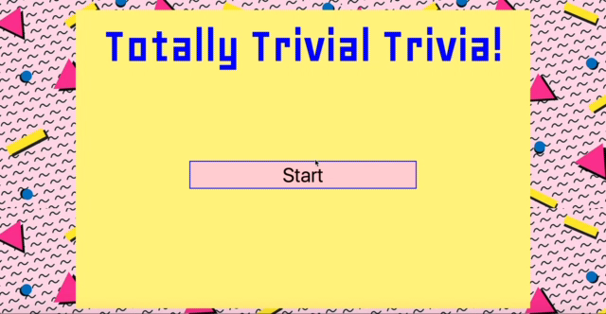
Homework Advanced

Slide 15
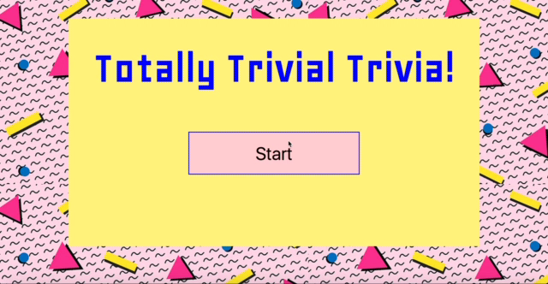
Homework Basic

Slide 16
Questions

